Slide 1
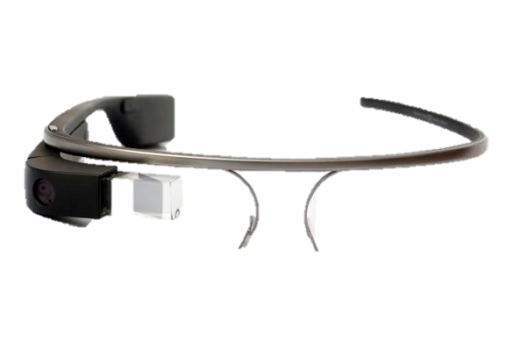
What is Google Glass?
1

Slide 2
Summary
Introduction to Google Glass
Components and technical features
How does it works ?
The uses
Derived products
Conclusion
2

Slide 3

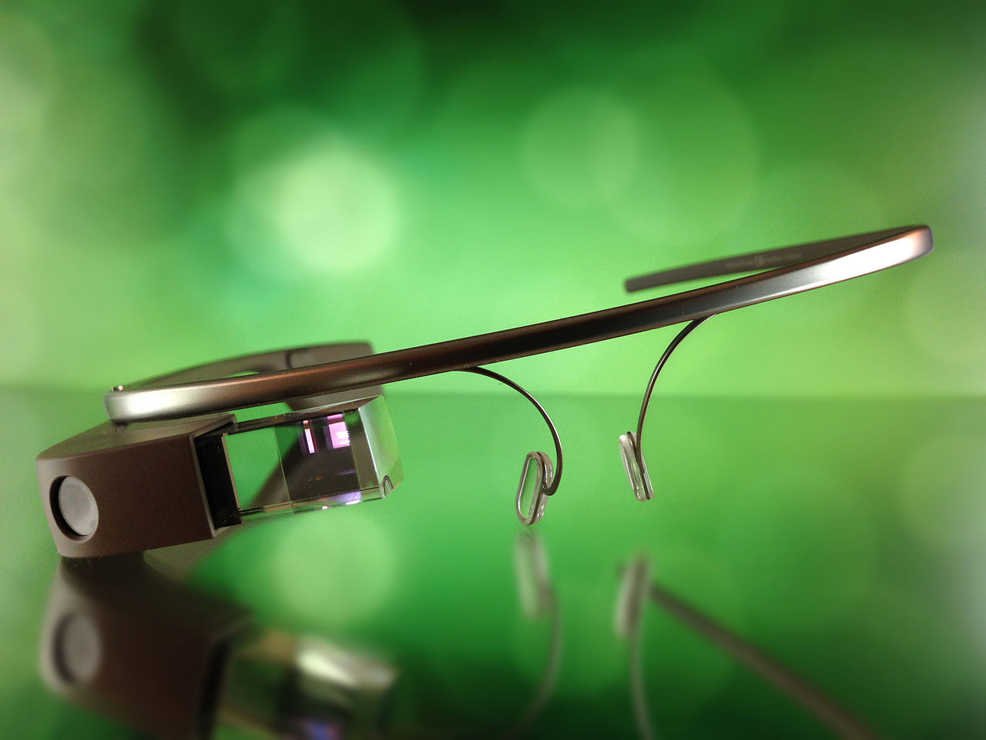
Introduction to Google Glass
- Prototype : april 15, 2013
- Developed by Google X
$1,500
Public may 15 2014
Google Glass Enterprise Edition
announced in july 2017
3

Slide 4
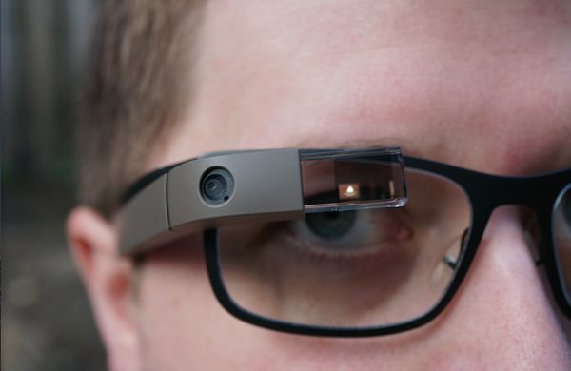
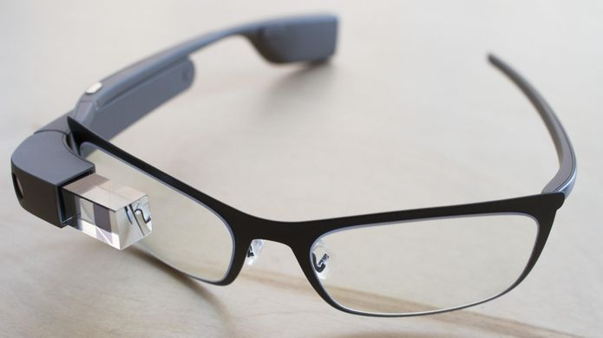
Components and technical features
- Touchpad
Glasses
Prism
2 GB ram
16 GB storage
Glass OS / Android
Wifi,Bluetooth
36g
Camera 5Mp , 720p video
Battery 570 mAh
Micro usb
4

Slide 5
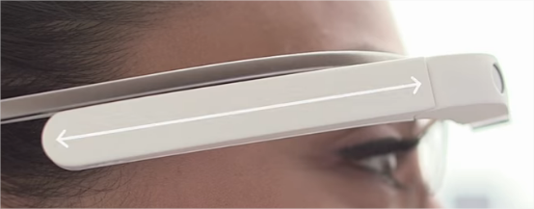
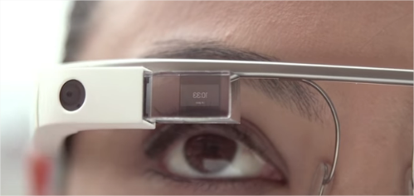
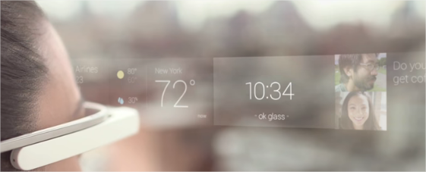
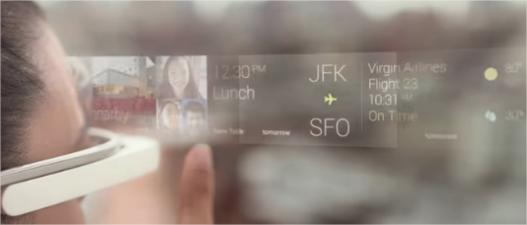
How does it works ?
5

Slide 6



The uses
Hospital Utilization
Surgeries and Procedures
Help autism people
poachers
6

Slide 7
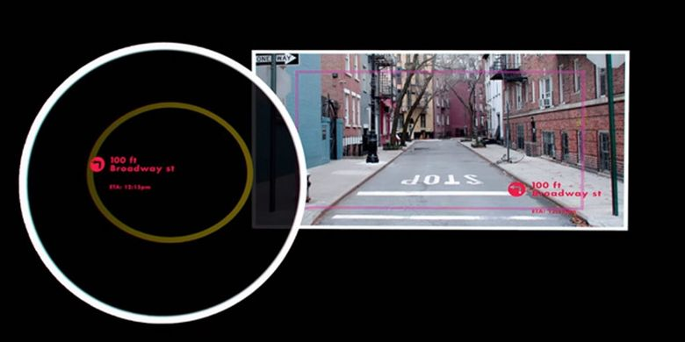
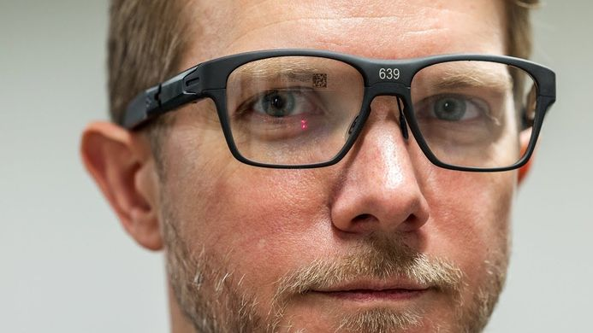
Derived products
IIntel Vaunt
7

Slide 8
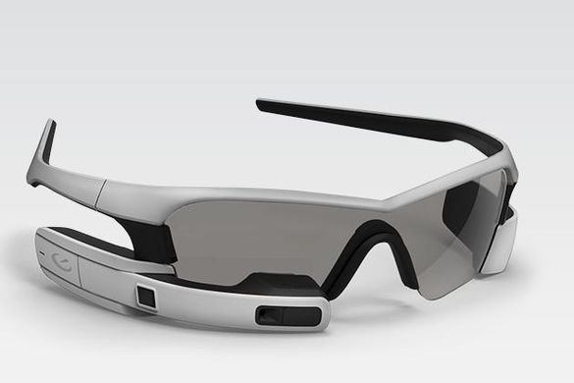
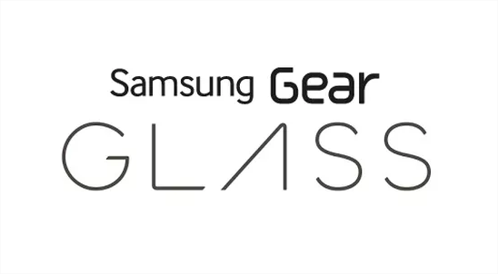
Derived products
Jet recon
Gear Glass (samsumg)
8

Slide 9
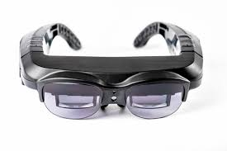
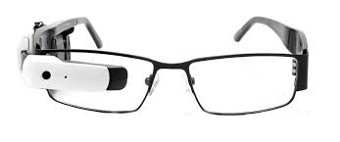
Vuzix M100
X1 Smart

Slide 10
General conclusion
Multi task
Can used with others devices
Improve hands-free initiatives
Any interference with vision
Take photo and video
Lightweight enough
Battery runs down quickly
No prescription eyewear users
New privacy issues
Project is stop
Very expensive
Utopia
9

